Slide 2


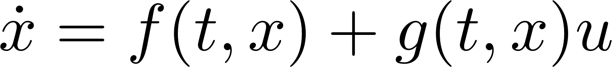



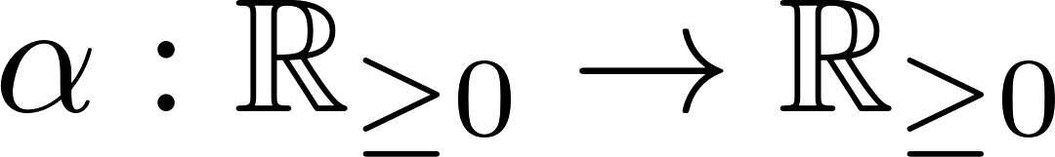


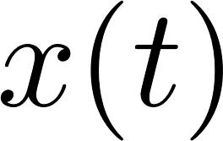



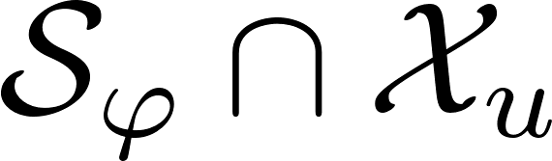
Introduction - Control Barrier Functions
Control Barrier Functions (CBFs) [1] are a tool for set invariance
  Let be a time-domain and be a state domain
  Control-affine system:
  Let denote the set of unsafe states (e.g. states that correspond to collisions with obstacles)
  Given a function and class- function
  , the condition [1]
  is sufficient to render the state trajectory always inside
  Design so that is empty
[1] Ames et al, “Control barrier functions: Theory and applications”, ECC 2019

Slide 3
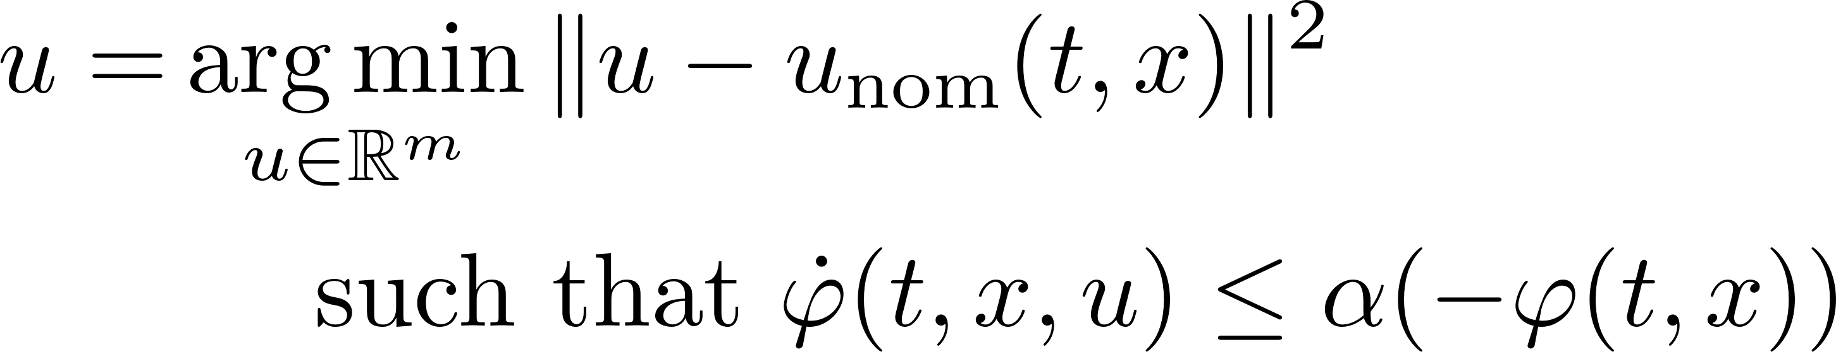
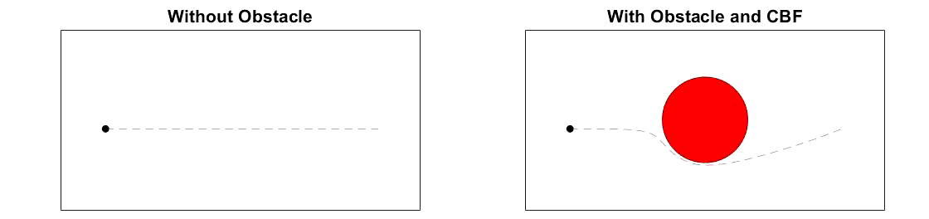
Introduction – Online Safety-Critical Control
CBFs are commonly implemented via online modifications of a nominal control law using the quadratic program

Slide 4
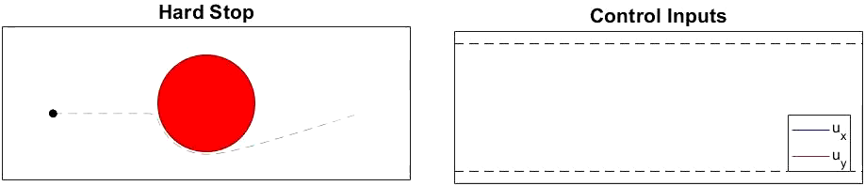
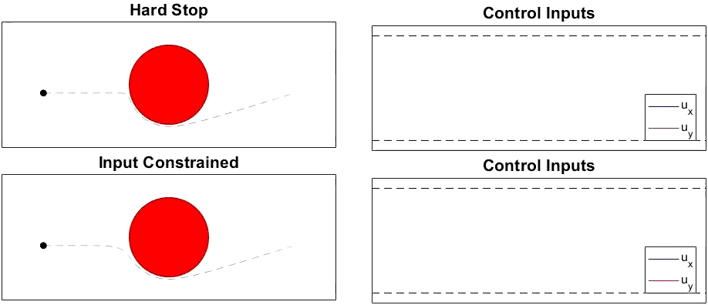
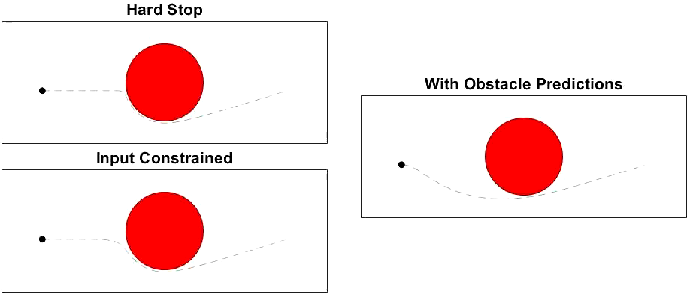
Introduction
These online modifications often result in
  Aggressive
  control responses
  and/or
  Inefficient/late
  control responses
Hypothesis: Considering the future trajectories of the system when choosing the present control input will mitigate the above behaviors
  This is the guiding principle of Model Predictive Control (MPC) (e.g. [1])
[1] Grandia et al., “Multilayered safety for legged robots via control barrier functions and model predictive control”, ICRA 2021

Slide 5


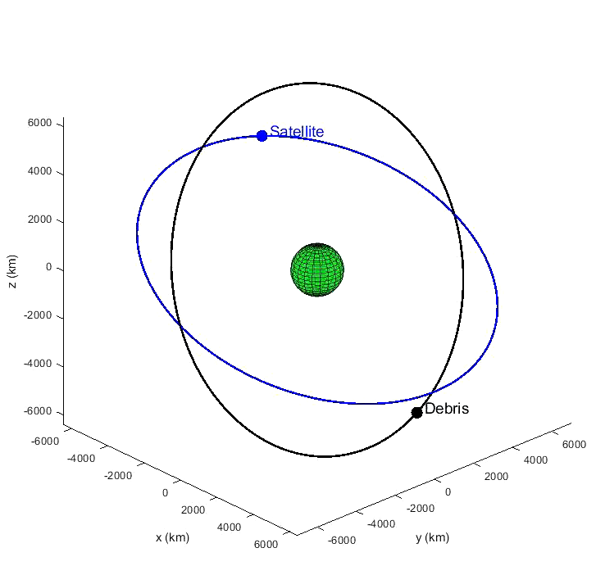
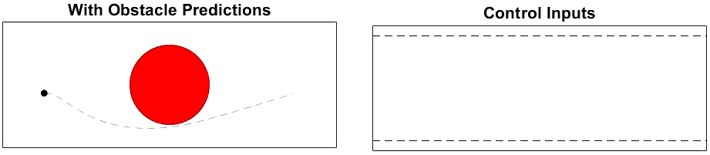
Problem Statement
Develop a CBF that is aware of the future trajectory of the system under
on a finite horizon and that adjusts this trajectory long before safety is violated
Work directly with nonlinear dynamics

Slide 6
Overview
Defining the “future trajectory” of the system
Analyzing the future trajectory
Encoding the “Predictive CBF”
Simulations
Discussion

Slide 7
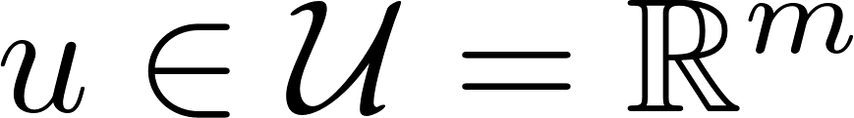


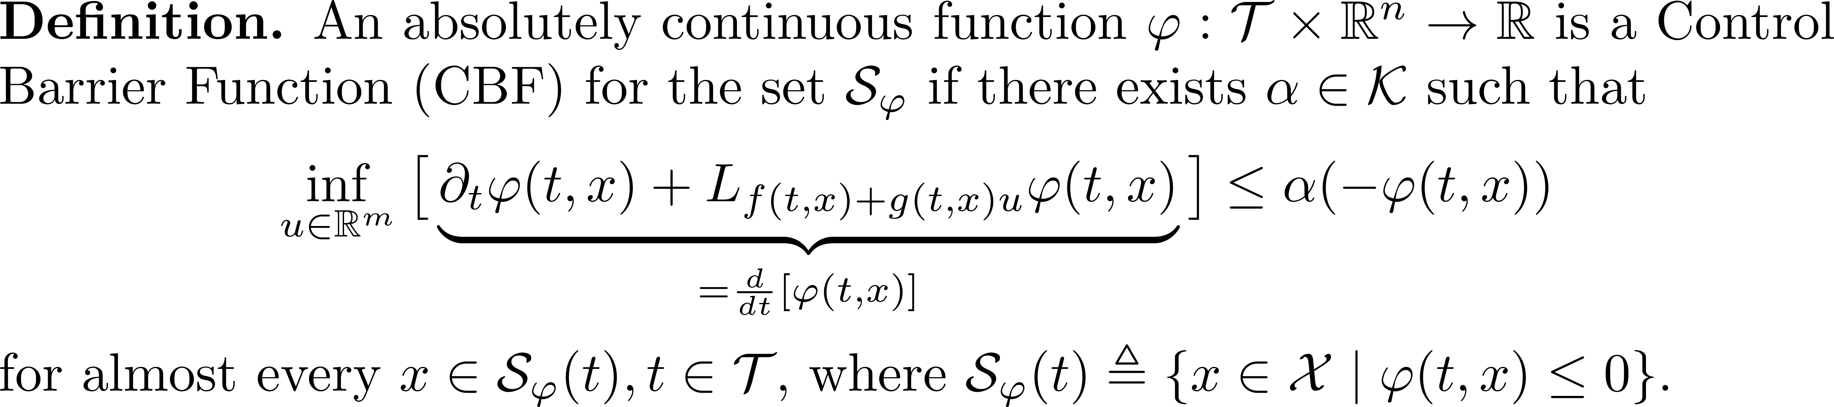
Preliminaries
System:
Control input unconstrained, i.e.
Safety function and safe set
where is not a CBF, and can be of any relative-degree

Slide 8
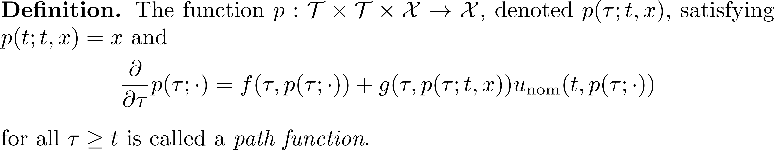

Defining the “Future Trajectory”
Suppose a nominal control input
is potentially unsafe, so this is not a “Backup CBF” [1-3]
[1] Squires et al., “Constructive barrier certificates with applications to fixed-wing aircraft collision avoidance,” CCTA 2018
[2] Chen et al., “Guaranteed obstacle avoidance for multi-robot operations with limited actuation: A control barrier function approach,” LCSS 2021.
[3] Wabersich and Zeilinger, “Predictive control barrier functions: Enhanced safety mechanisms for learning-based control,” TAC 2022.

Slide 9

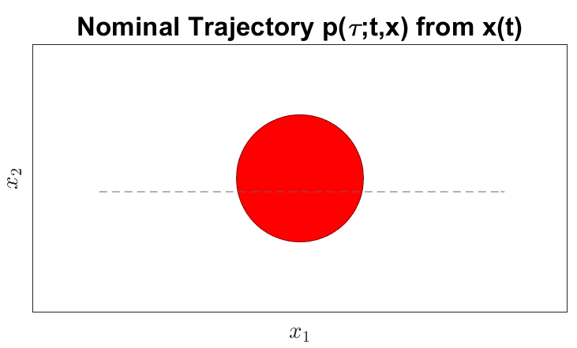
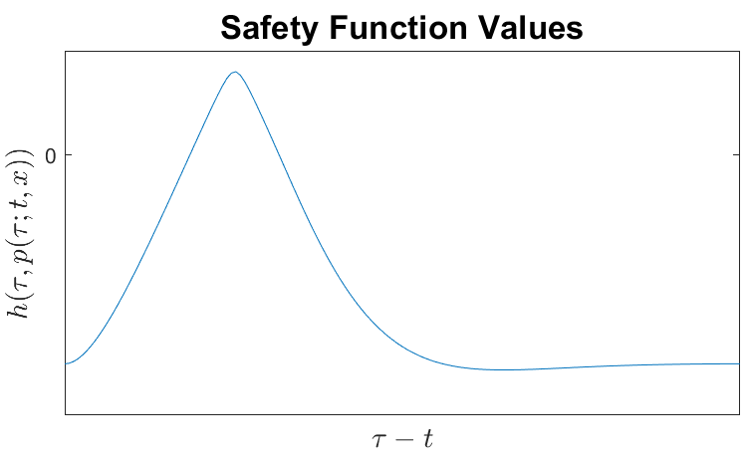
Analyzing the Future Trajectory
Propagate trajectory for receding time horizon
Compute safety function along the hypothetical trajectory

Slide 10
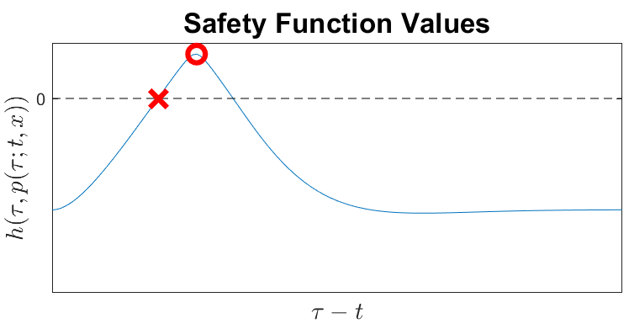
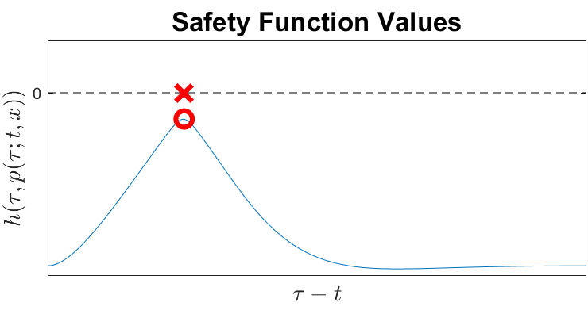
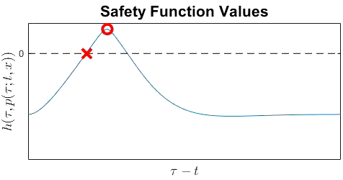
Analyzing the Future Trajectory
Question: Is the future trajectory (on a finite horizon) safe?
“No”:
  When does the trajectory become unsafe?
  By how much does the trajectory become unsafe?
“Yes”:
  When does the trajectory become least safe?
  By how much margin is the trajectory safe?

Slide 11
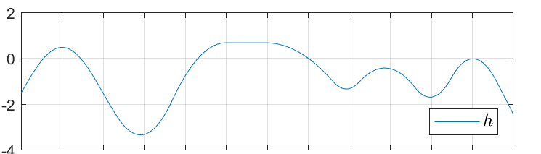
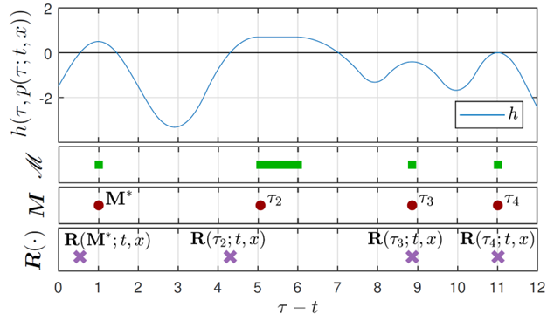
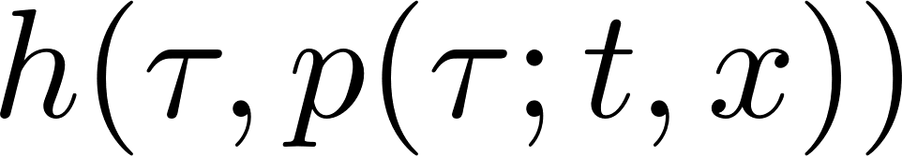

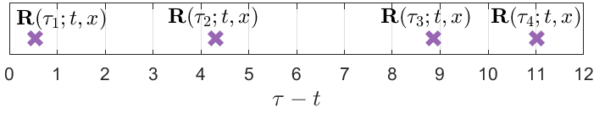
Times of Interest
All Local Maximizers
Isolated Local Maximizers
Roots

Slide 12
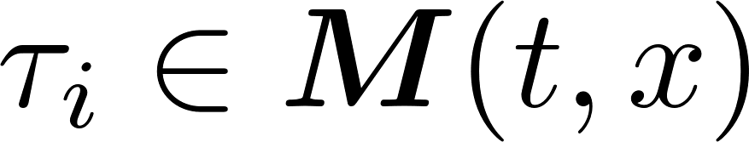
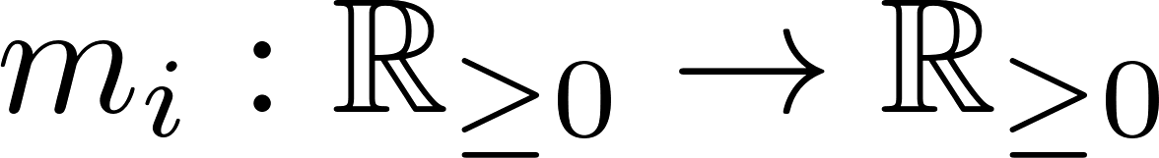
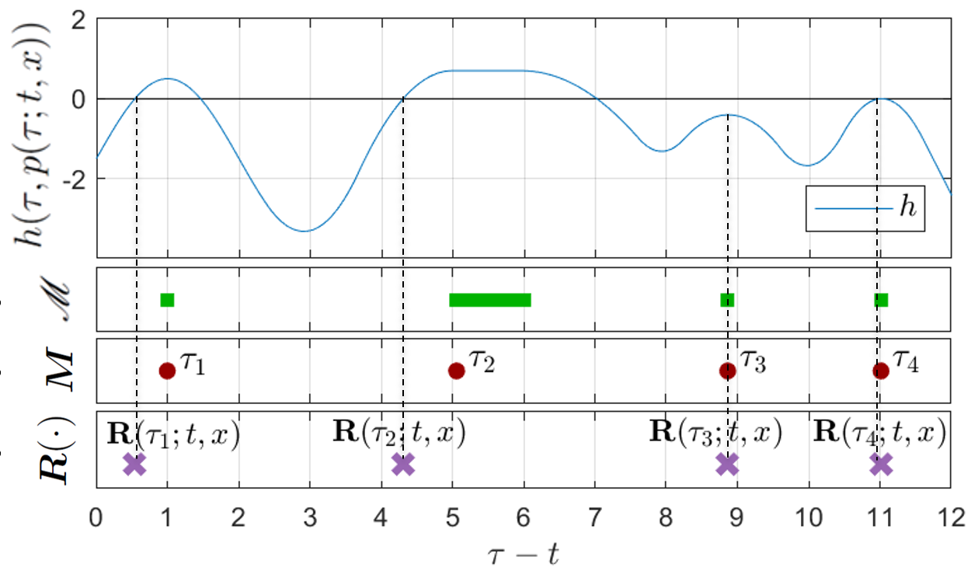
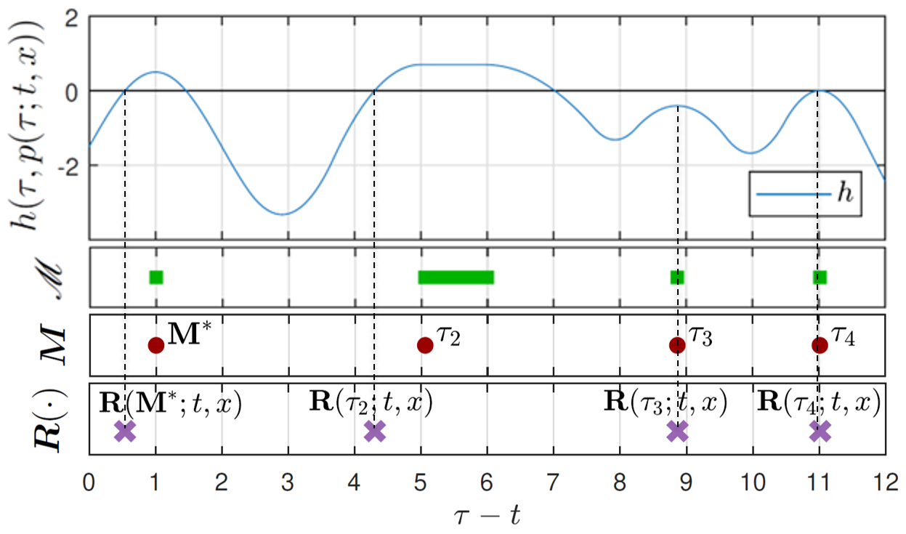

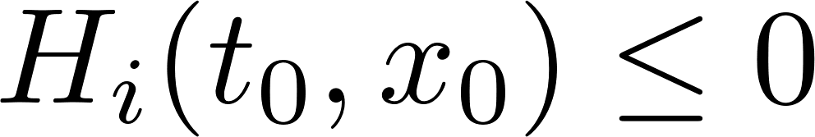
Encoding the Predictive CBF
Given a time
Given a time and a nondecreasing function , define the “Predictive CBFs”:
Choose so that
Amount by which safety is violated, or amount of margin
Time to make correction*
*See also Black et al., “Future-Focused Control Barrier Functions for Autonomous Vehicle Control”, arXiv

Slide 13
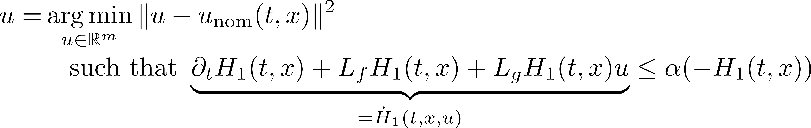
Main Result
See next slide for assumptions

Slide 14
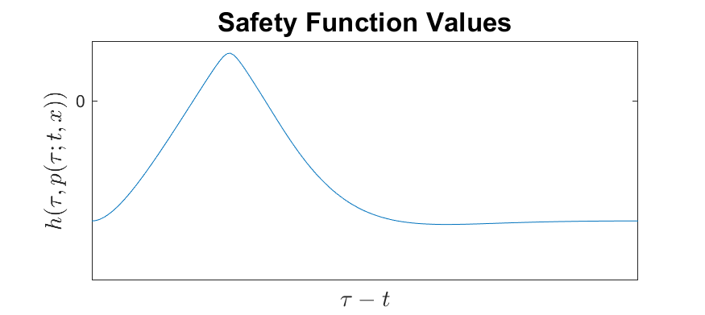
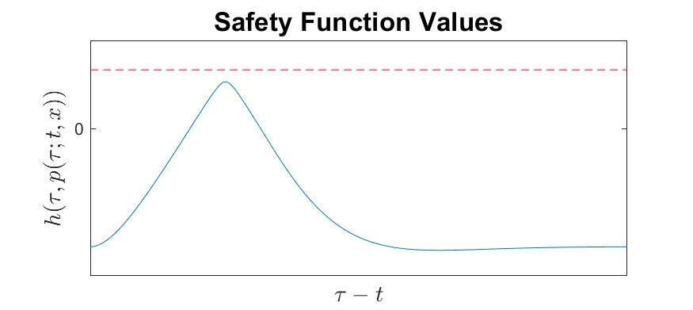
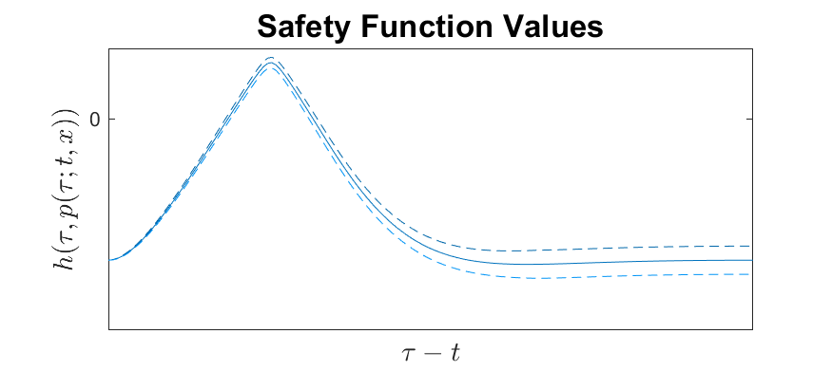
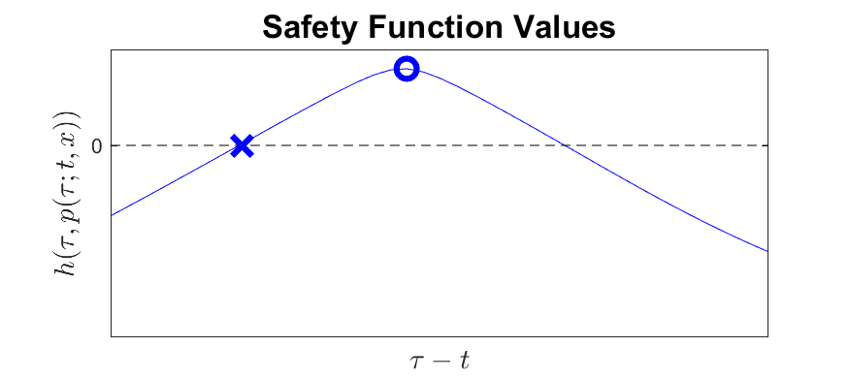
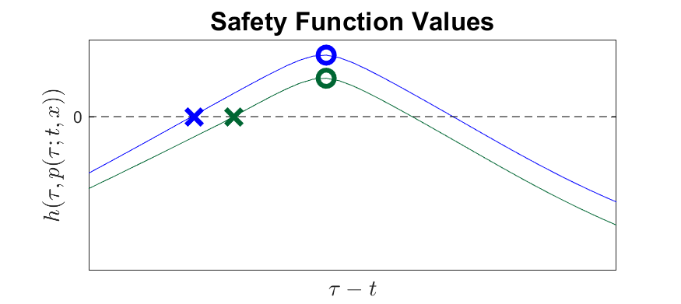
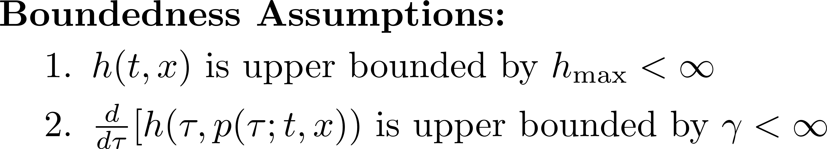



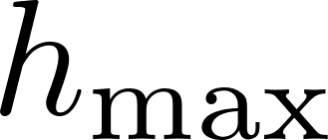

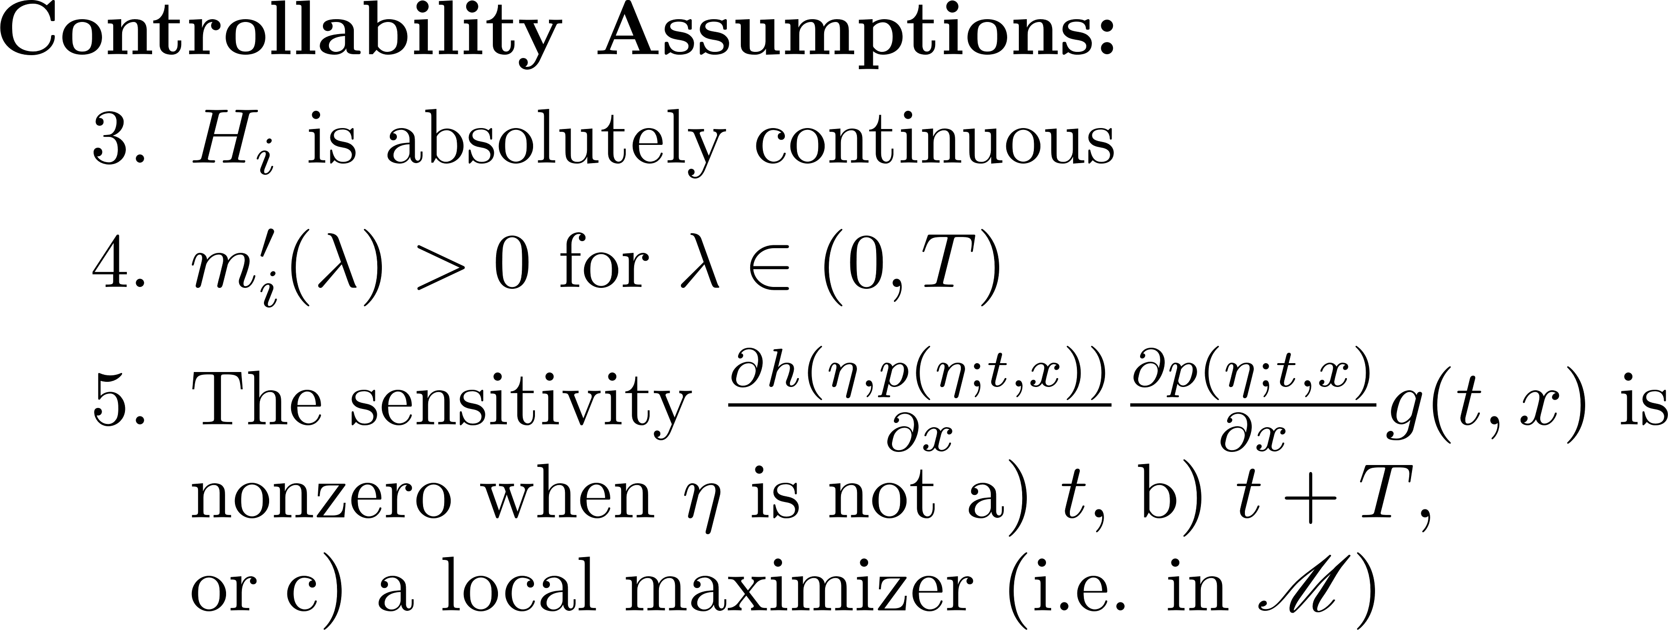
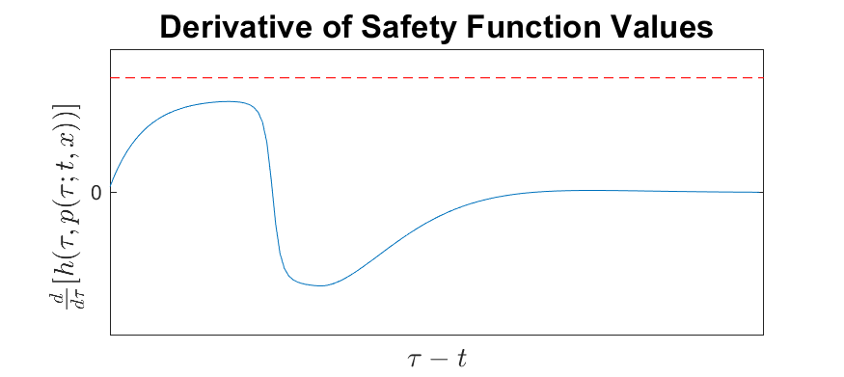

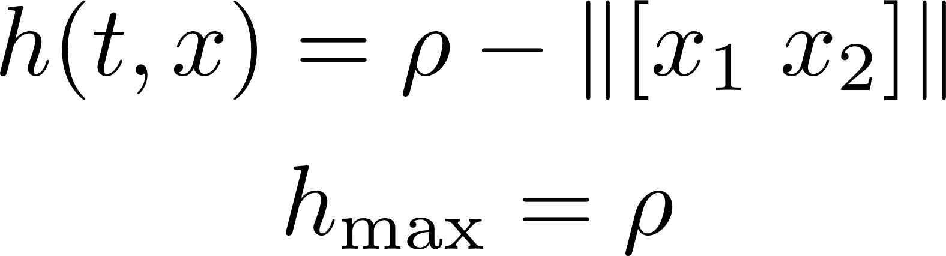
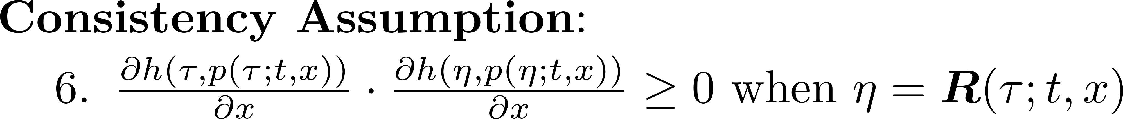
Main Result - Assumptions

Slide 15
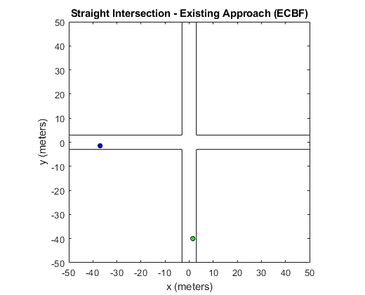
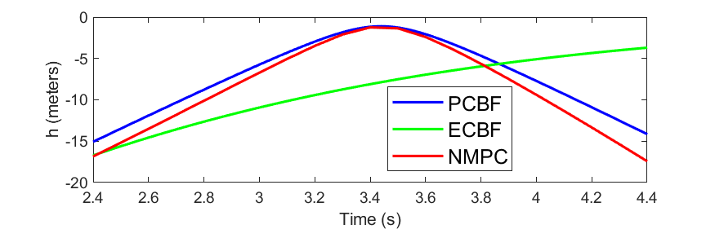
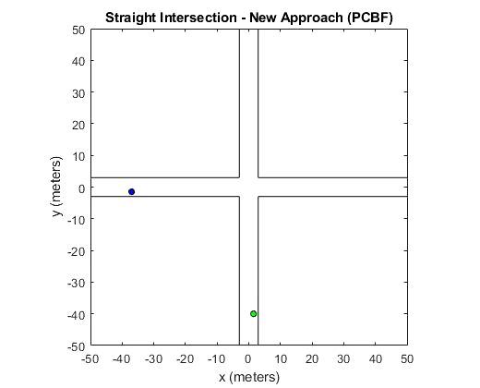
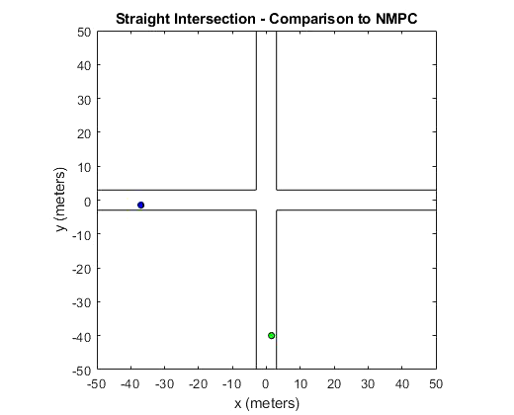
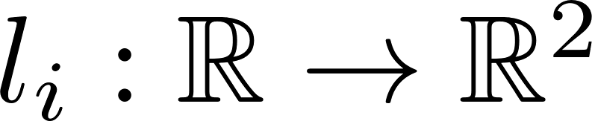
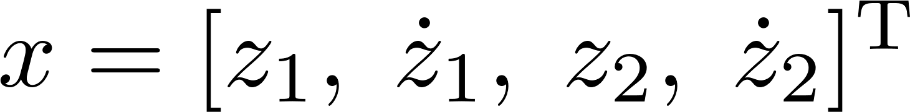

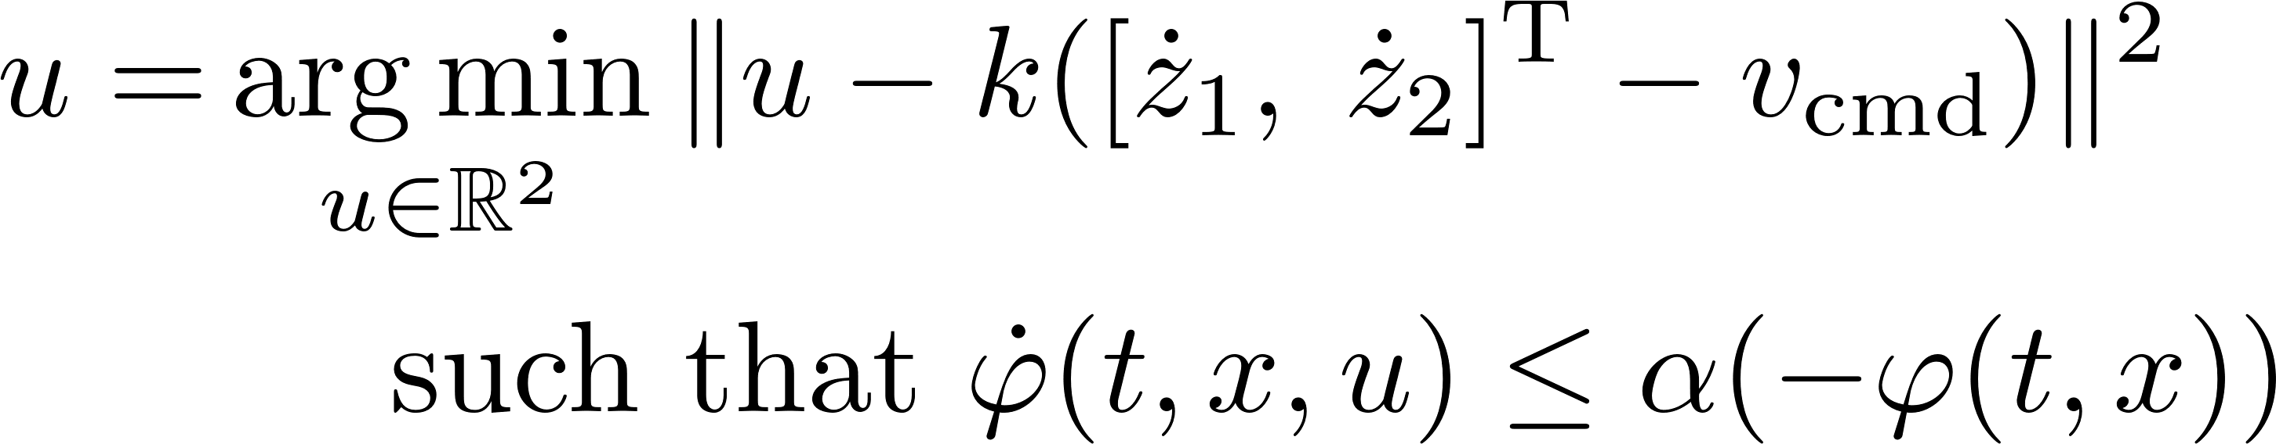
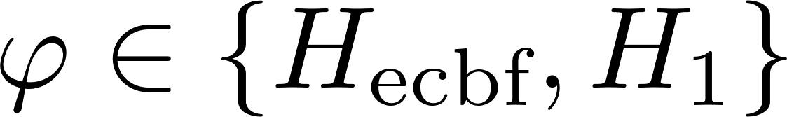
Simulation Results – Cars Straight Intersection
Vehicles fixed in lanes
and modeled as double integrators
Nominal control is to track a command velocity
Safety requirement
Safe control input is
where .
https://youtu.be/0tVUAX6MCno
ECBF Comparison: Nguyen and Sreenath, “Exponential control barrier functions
for enforcing high relative-degree safety-critical constraints”, ACC 2016

Slide 16
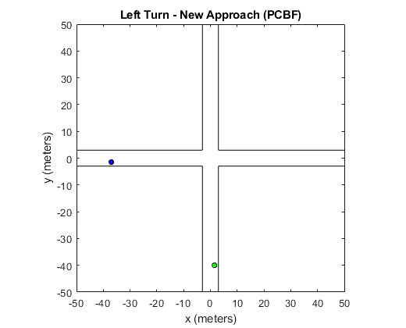
Simulation Results – Cars Left Turn Intersection
Average control computation times:
  ECBF: 0.0011 s
  PCBF: 0.0061 s
  NMPC: 0.40 s
Simulations in MATLAB
ECBF + PCBF controller computed with quadprog
NMPC controller computed with nlmpc + fmincon using SQP algorithm limited to 8 iterations
https://youtu.be/0tVUAX6MCno

Slide 17
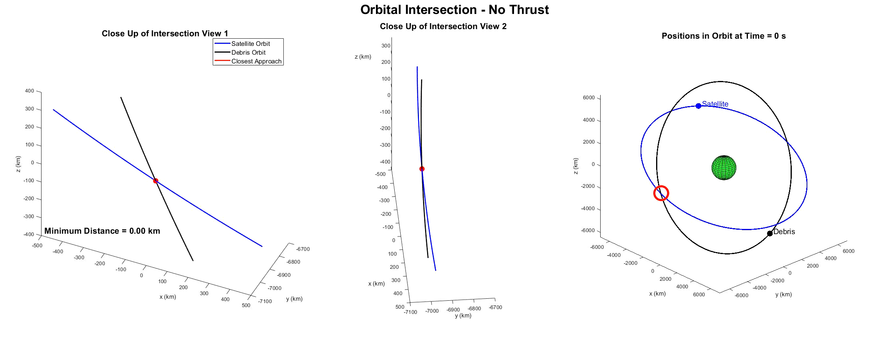


Simulation Results - Satellites
https://youtu.be/HhtWUG63BWY
ECBF maintains safety by thrusting opposite the debris when the satellites are close.
Predictive CBF thrusts a quarter orbit in advance when less control effort is required.

Slide 18



Simulation Results - Satellites
Satellites have a 1 km radius keep out zone
Satellites orbit at 7.5 km/s
The minimum sample time to guarantee detection of an unsafe state is 0.143 s
At this discretization interval, NMPC with the same horizon as the PCBF would require 9800 samples, which is impractical.

Slide 19




Conclusions
We have presented a new framework for constructing CBFs for generic safety functions using future trajectory predictions
The Predictive CBF takes into account the future trajectories the system is expected to follow and modifies these trajectories before reaching unsafe states
Compared to MPC, the Predictive CBF
  followed similar trajectories in simulation
  yields a pointwise control-affine safety constraint
    Results in a convex QP control law even for nonlinear dynamics and constraints
    QP is -dimensional (where ) instead of -dimensional as in MPC
  evaluates safety over a continuous predicted trajectory without fixed sampling (important for satellite simulations or other rapidly evolving systems)

Slide 20

Ongoing Work
Provably guaranteed input constraint satisfaction
  Currently, input constraint satisfaction is achieved via tuning
Distributed Systems
Predictions with uncertain obstacles
Improving a specified cost metric (similar to MPC)
Pairwise Safety Function Values

Slide 21


Thank You To Our Sponsors

